Slide 1

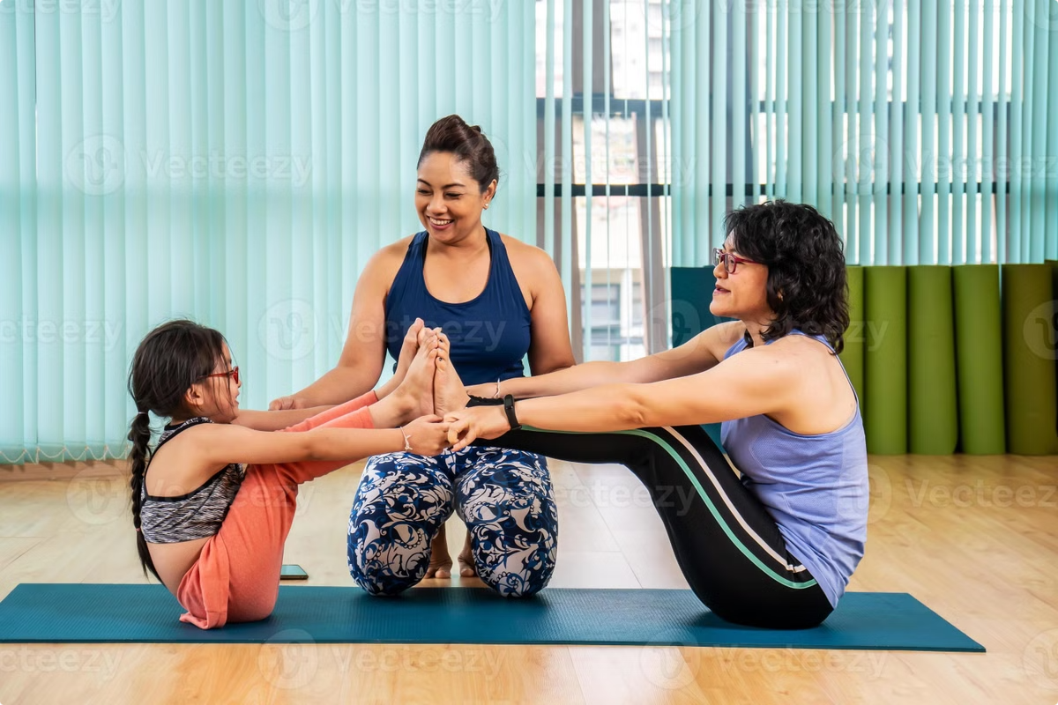

Absolute Yogi
Transforming how the world practices yoga.
by Rushi Kongara

Slide 2

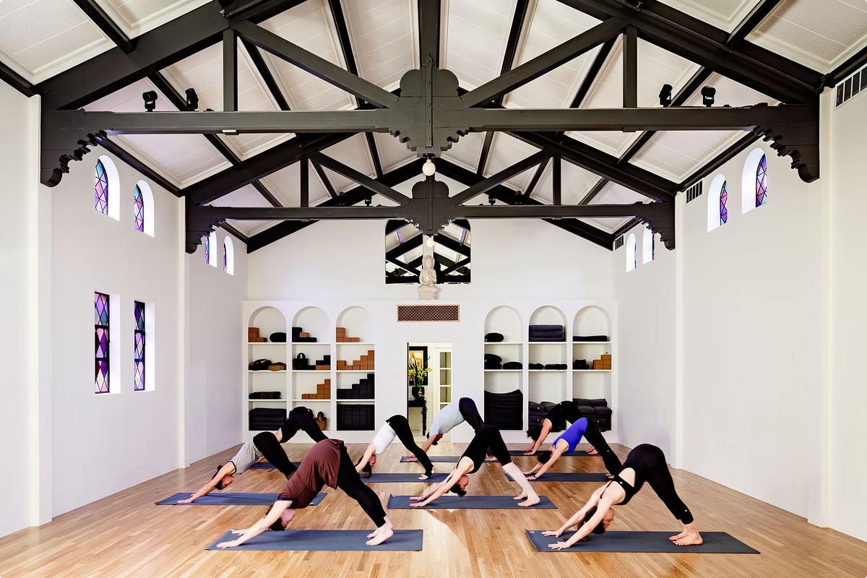
Problem
1
Unmet Need
Over 300 million people practice yoga.
2
Current Limitations
Traditional studios are expensive and time-consuming.
3
Market Gaps
No existing product combines personalized guidance with at-home practice.

Slide 3


Solution
Absolute Yogi
AI-powered holographic yoga coach.
Features
Real-time feedback on posture, balance, and breathing.
Technology
Combines computer vision, AR, and AI.
Convenience
Accessible 24/7, adapting to any space.

Slide 4
Benefits
Personalized Guidance
Immersive Experience
Holistic Approach
Real-time feedback replicates the quality of a live instructor.
The AR projection creates a studio-like atmosphere.
Integrates mindfulness and breathwork.

Slide 5

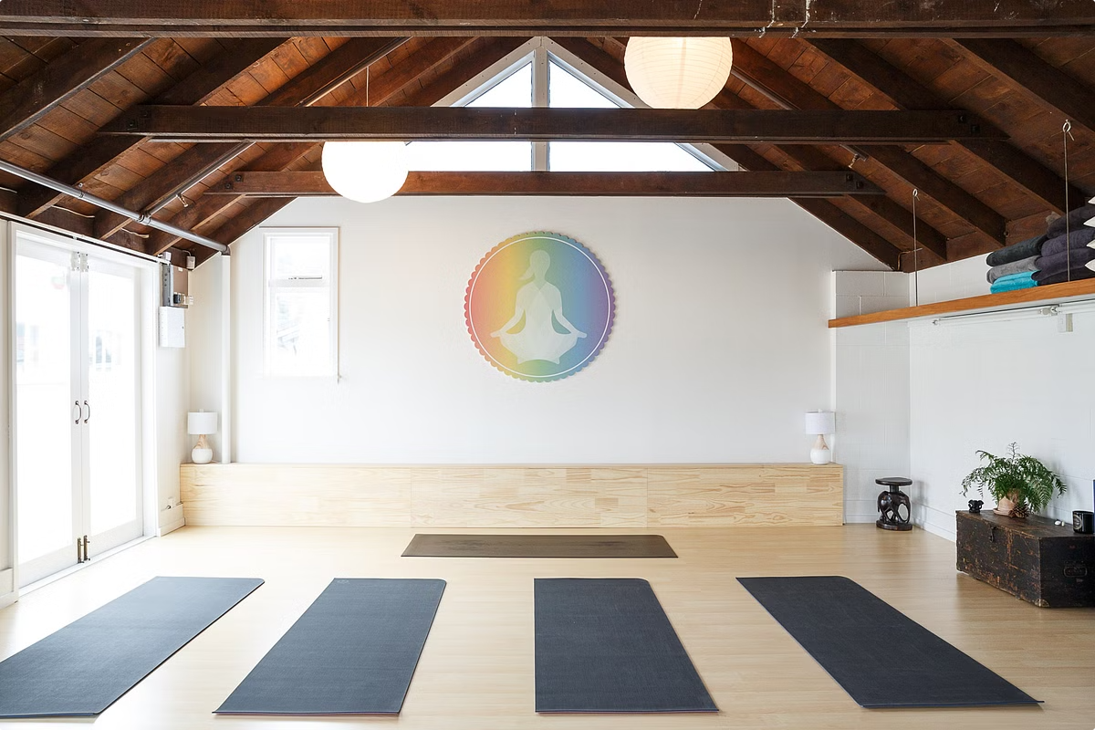
Assumptions & Validation Roadmap
1
Assumptions
Users prefer interactive, immersive experiences.
2
Validation Roadmap
Phase 1: Early prototype testing with target demographics.
3
Phase 2
Beta launch with a subscription model.
4
Phase 3
Scaling through strategic partnerships.

Slide 6

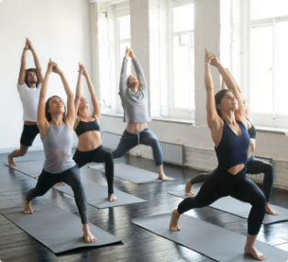




What Makes Us Special
Unique Selling Proposition
Technological Edge
Customer-Centric Design
Partnership Potential
Our proprietary AI algorithms for posture correction and session customization provide a depth of personalization unmatched by existing fitness apps or AR solutions.
Opportunities for co-branding with wellness companies, fitness influencers, and digital health platforms.
Absolute Yogi is the only product that merges AI, AR, and personalized real-time feedback.
Designed with the modern user in mind, offering flexibility, convenience, and a holistic approach to wellness.

Slide 7

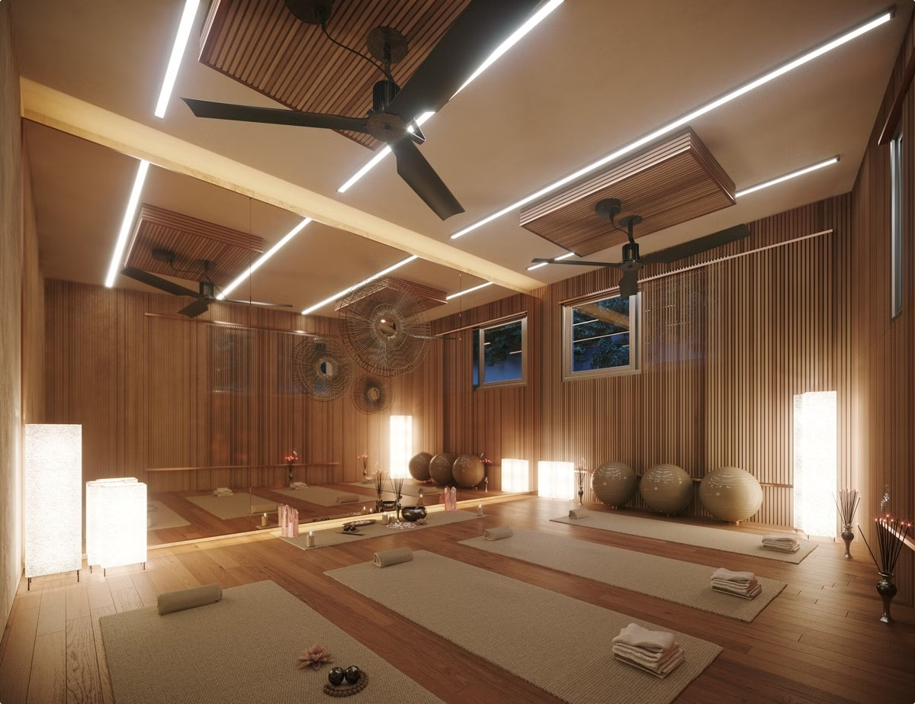
Business Model
Revenue Streams
Subscription Model
One-Time Purchases
Partnerships & Licensing
Customer Acquisition Strategy
Digital marketing, influencer partnerships, community building through social media.
Referral incentives
Retention Strategy
Engaging user experience, personalized progress tracking, and continuous content updates.

Slide 8





Market
Total Addressable Market (TAM)
$25 billion global market for fitness technology and home wellness solutions.
Serviceable Available Market (SAM)
$10 billion focused on yoga, mindfulness, and at-home fitness enthusiasts.
Serviceable Obtainable Market (SOM)
Targeting $1 billion within the first 3 years.

Slide 9

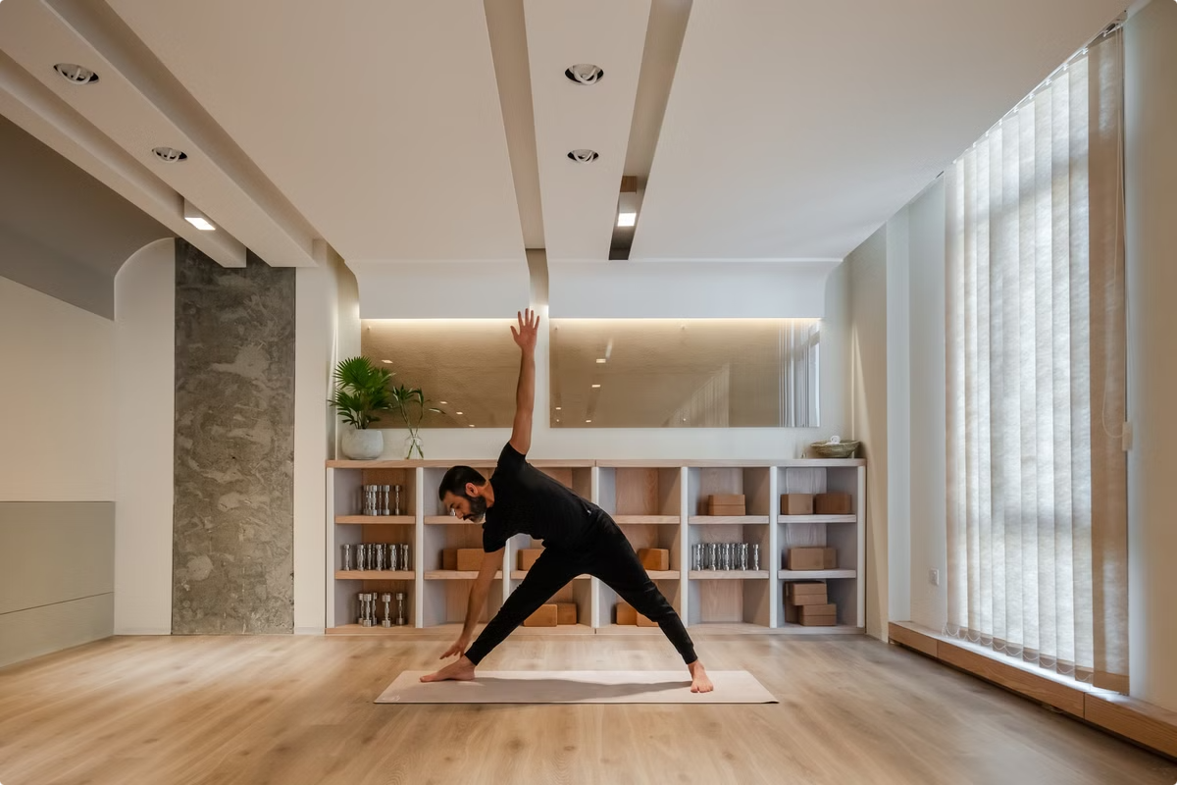
Sponsorship Ask
1
Investment Request
$500,000 for 10% equity.
2
What We Need
Financial backing to accelerate product development and scale rapidly.
3
What We Offer
A stake in a high-growth company positioned to disrupt the multi-billion-dollar fitness tech market.

Slide 10

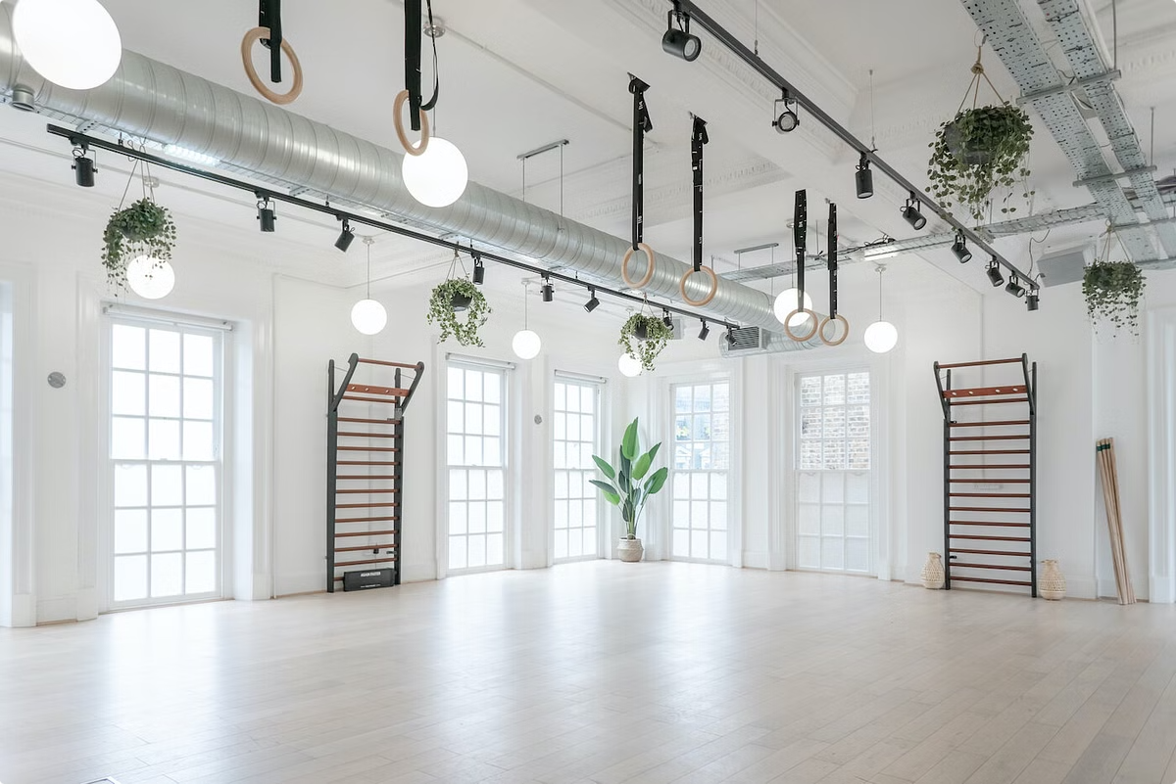
Closing Statement
Absolute Yogi isn’t just about yoga; it’s about creating a new era of personalized, interactive wellness that meets the needs of today’s digital world.

